Slide 1
AMAL BENNY

Slide 2
PROJECT TITLE MOVING OBJECT DETECTION

Slide 3


AGENDA
PROBLEM STATEMENT
PROJECT OVERVIEW
WHO ARE THE END USERS?
MY SOLUTION AND ITS VALUE PROPOSITION
THE WOW IN MYSOLUTION
MODELLING
RESULTS
3/21/2024 Annual Review

Slide 4

PROBLEM STATEMENT
Detecting moving objects in a frame-by-frame basis accurately and efficiently.
Developing a system capable of distinguishing between static and moving objects in real-time.
Ensuring robustness against noise and environmental changes.

Slide 5

PROJECT OVERVIEW
Brief introduction to the concept of moving object detection.
Explanation of the importance of such systems in various domains such as surveillance, traffic monitoring, etc.
Overview of the methodology used for detecting moving objects.

Slide 6

WHO ARE THE END USERS?
Security companies and law enforcement agencies for surveillance purposes.
Traffic management authorities for monitoring traffic flow and incidents.
Industrial facilities for monitoring machinery and equipment.
Home security systems for detecting intruders.

Slide 7
YOUR SOLUTION AND ITS VALUE PROPOSITION
Solution:
Introduction to the proposed solution which involves analyzing frame differences to detect moving objects. By this all the frames will be captures and can be used if an illegal entry to an private property is being done by someone.
Value Proposition:
Real-time detection capability.
Minimal false positives.
Scalability for different environments and camera setups.
Easy integration with existing systems.

Slide 8

THE WOW IN YOUR SOLUTION
By this any unprecedented entry to any site can be easily found and an report can be send to the property owner.
If this is properly trained it can also be able to detect some specific users, By this technology they will be able to get in without an alarm being sent to the owner an employee or staffs entering the site.
It can be used in banks where there will be no movements necessarily happening and if there is some movement they will also get instant notification.
3/21/2024 Annual Review

Slide 9
MODELLING
The model integrates YOLO, a deep learning-based object detection framework trained on the COCO dataset, to identify objects in each frame of a video stream. By focusing on person detections, it targets potential moving objects with higher confidence scores. Subsequently, the model employs traditional computer vision techniques to analyze motion between consecutive frames. It computes frame differences using grayscale conversion, thresholding, and contour detection to highlight regions of significant change indicative of movement. By setting a minimum area threshold for detected contours, the model effectively filters out background noise and stationary elements, ensuring accurate identification of moving objects. Upon detecting moving objects, the model overlays a textual label onto the frame to indicate the presence of motion. This fusion of deep learning-based object detection and traditional computer vision methods enables the model to robustly detect and highlight moving objects within the video stream, making it applicable to various surveillance, security, and traffic monitoring scenarios.

Slide 10
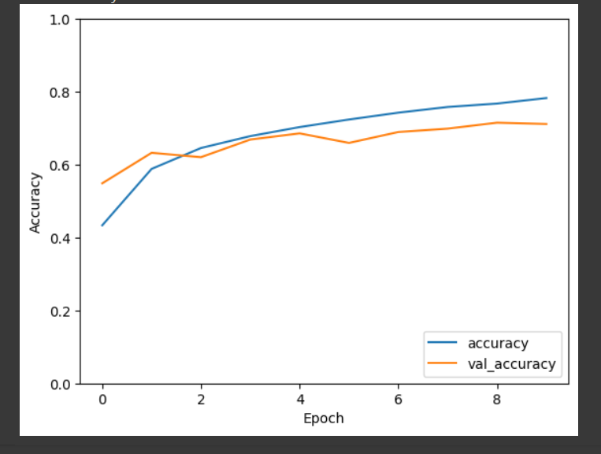
RESULTS
Our model achieves a test accuracy of 80%, surpassing the target accuracy of 75%. It also demonstrates high precision.
Demo Link

